Slide 1
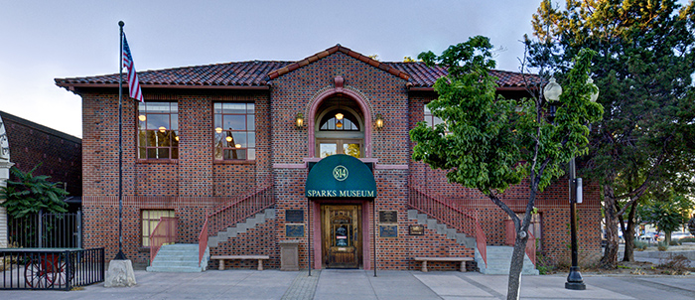
Sparks Museum & Cultural Center 2019 Annual Report
Presenter: Richard C. Simmonds, D.V.M., M.S., ACLAM
President, Board of Trustees

Slide 2
SPARKS MUSEUM & CULTURAL CENTER Balance STATEMENT AS OF May 31, 2019
 | May 31, 2018 | May 31, 2019
Total Assets | $280,006 | $278,627
Total Liabilities (L) | $2,471 | $5,358
Total Equity (E) | $277,535 | $273,269
Total L & E | $280,006 | $278,627

Slide 3
SPARKS MUSEUM & CULTURAL CENTER Budget for June 1, 2019 – May 31, 2020
BUDGET
Expenses | $47,000
Revenues | $47,000
Difference | $0

Slide 4
SPARKS MUSEUM & CULTURAL CENTER Revenue breakdown
PROGRAM DESCRIPTION | 2019-2020 EST. REVENUES
Admissions | $4,500
Gift Shop | $4,000
Facility Rentals | $6,000
Membership Dues | $10,000
Contributions, Memorials (Non-Restricted) | $10,000
Seminars, Bus Tours and Presentations | $2,000
License Plate Program | $4,000
Other | $6,500
Total Revenue | $47,000

Slide 5
2018-19 activities First Saturday Lecture series
“Lost Carson City”
Outdoor Photography
“World Endangered Species Present a Crisis for Humanity”
There’s No Lake on Lake Street
Lincoln Highway

Slide 6
2018-19 activities First Saturday Lecture series
Harold’s Club
The Keck Museum at UNR
Commemorating the History of 4th Street and Prater Way
One Truckee River
Celebration of Apollo 11’s Historic Landing on the Moon

Slide 7
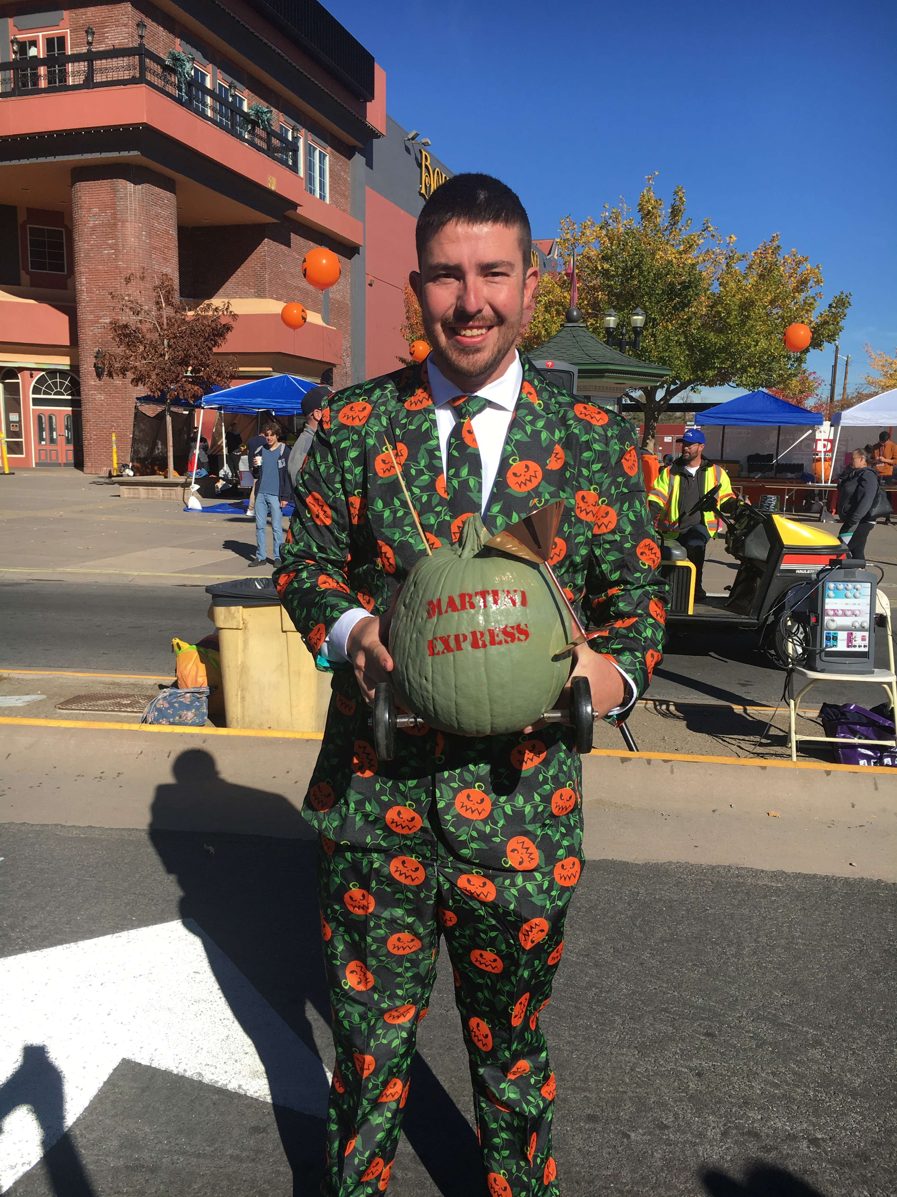
2018-19 activities
Sierra Watercolor Society, Art Exhibit/Reception
Reception: Tweed Bicycle Day
Pumpkin Palooza generated 417 museum visits and 1,486 train visits
Swing Dance Group

Slide 8
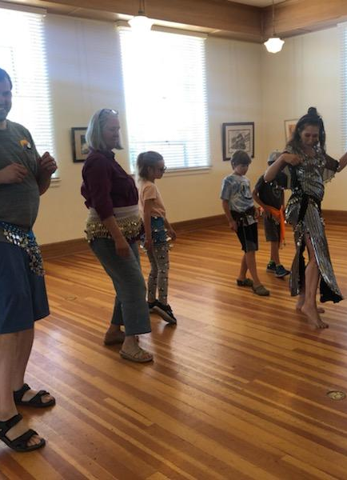
2018-19 activities
Pictures with Santa Claus after Sparks Christmas Parade in the Cultural Center
Rotary Event
Private Memorial
Scott Carey’s Walking Tour
Artown event in Sparks included Eileen Fuller, the Latimer Art Club and Spark the Imagination.

Slide 9
Geographic Origins of 2019 Visitors*
* Numbers do not equal 100% - signing our “Visitors’ Register” is voluntary and many visitors do not indicate where they reside.

Slide 10
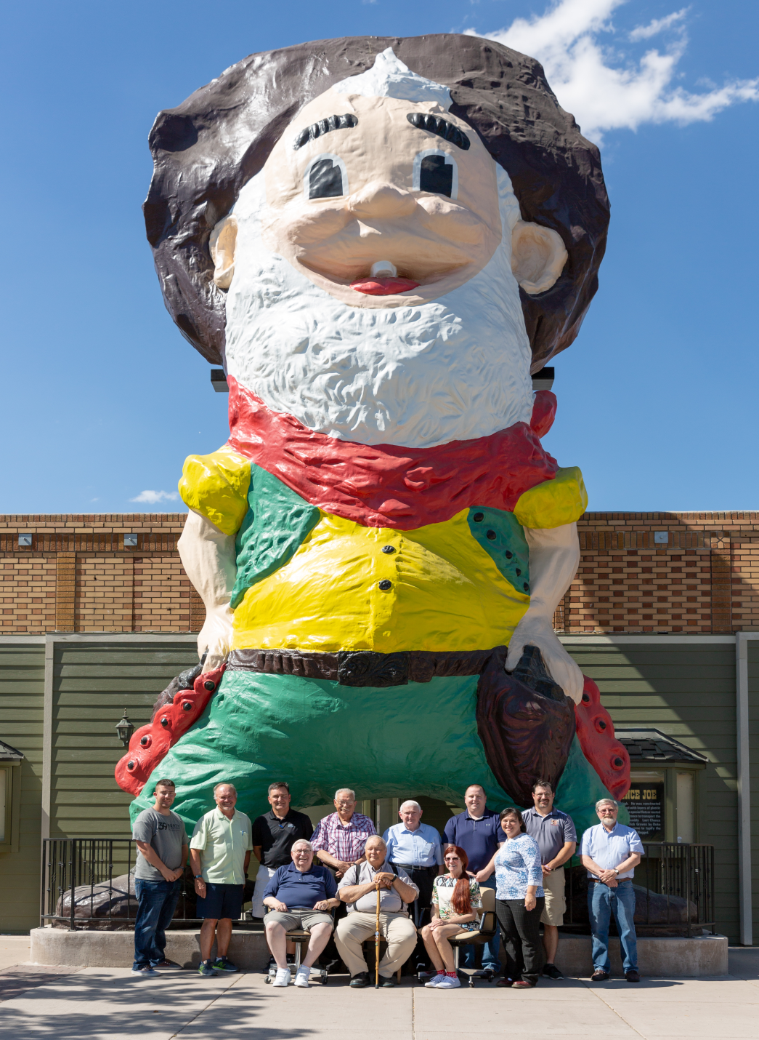
Sparks museum’s accomplishments
Last Chance Joe Restoration complete;
License Plate Sales to date: 179
Volunteers Joan Howard & Pam Lamberti, have kept the Glendale Schoolhouse open on a more consistent basis;
Attendance to Road Maps trainings offered by the City of Sparks.

Slide 11
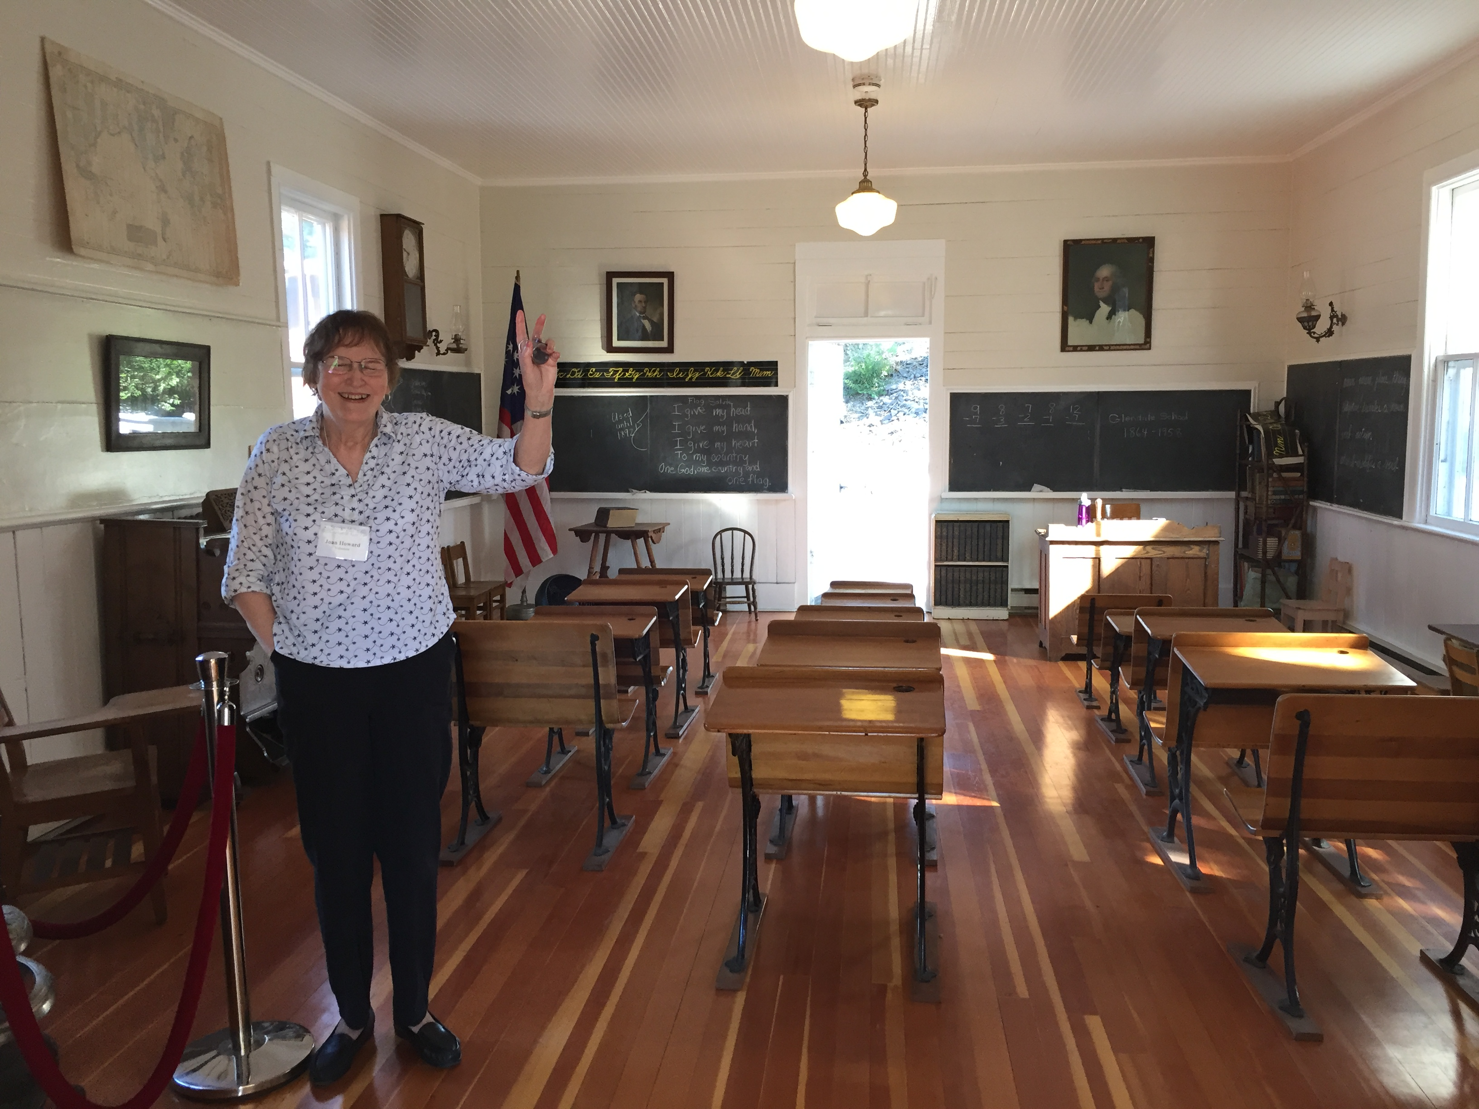
Sparks museum challenges
Difficult to recruit, train and retain volunteers
Limited financial resources for fundraising activities
Identification of resources needed to complete a Long Range Business and Operations Plan

Slide 12
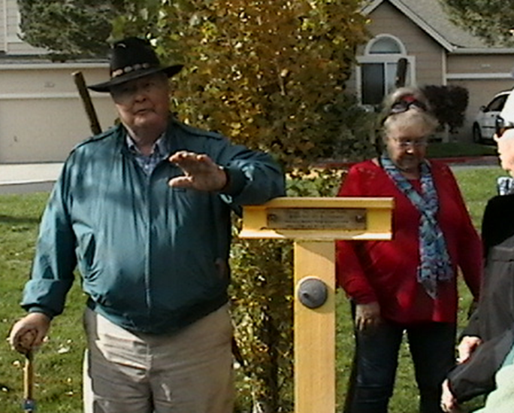
Celebrating our volunteers
4,295+ hours donated in FY19 by 32 volunteers;
Board of Trustees member & retired history teacher, Fred Horlacher, leads bus tours to historical points of interest in Northern Nevada.

Slide 13
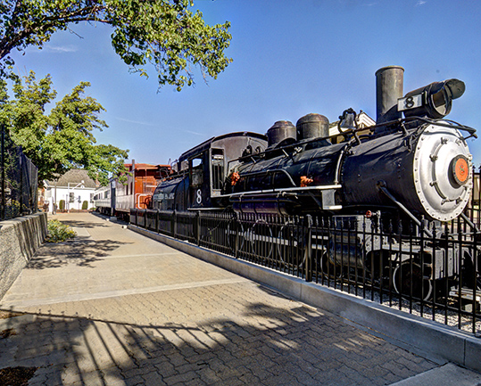
The Bicentennial Train Exhibit
Volunteer, Richard Peterson, maintains the inside of the Train weekly;
4,094 visitors in Fiscal Year 2018/19 of which 668 were on school tours, scout tours or children with adults all free

Slide 14
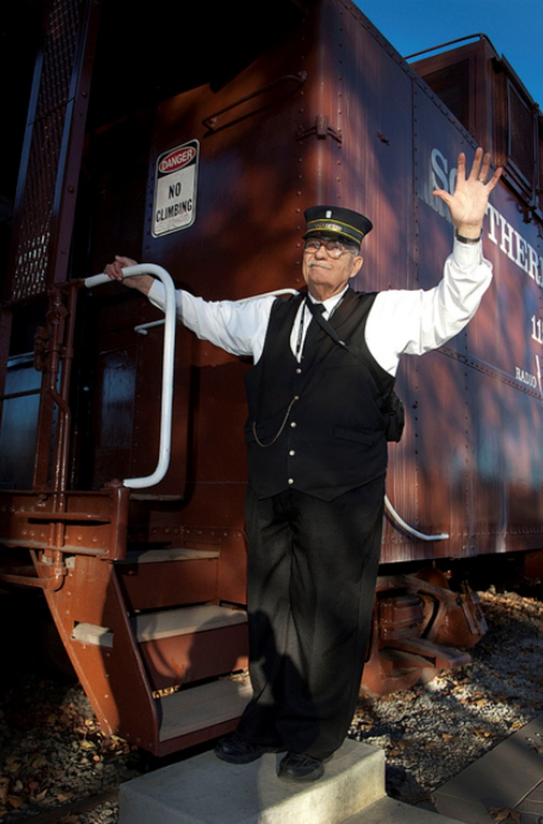
GUIDED MUSEUM TOURS Free to the community
12 School Class Tours (669 students & teachers)
Cub Scout Pack 315 (22 Scouts and Adults)
United Cerebral Palsy (91 Participants)
Seniors Morning Star Retirement Community (9 participants)
Just Kidding Learning Center Field Trip
A Child’s World
Seniors Its More to Life Group (3 separate tours)

Slide 15
FULL STEAM AHEAD!
Expand efforts to identify and recruit more volunteers;
Continue efforts to increase community awareness;
Expand the diversity of educational activities;
Continue to enhance visitor experiences by developing narrative explanation (s) for each exhibit; and
Continue efforts to expand fundraising strategies to support operations.

Slide 16
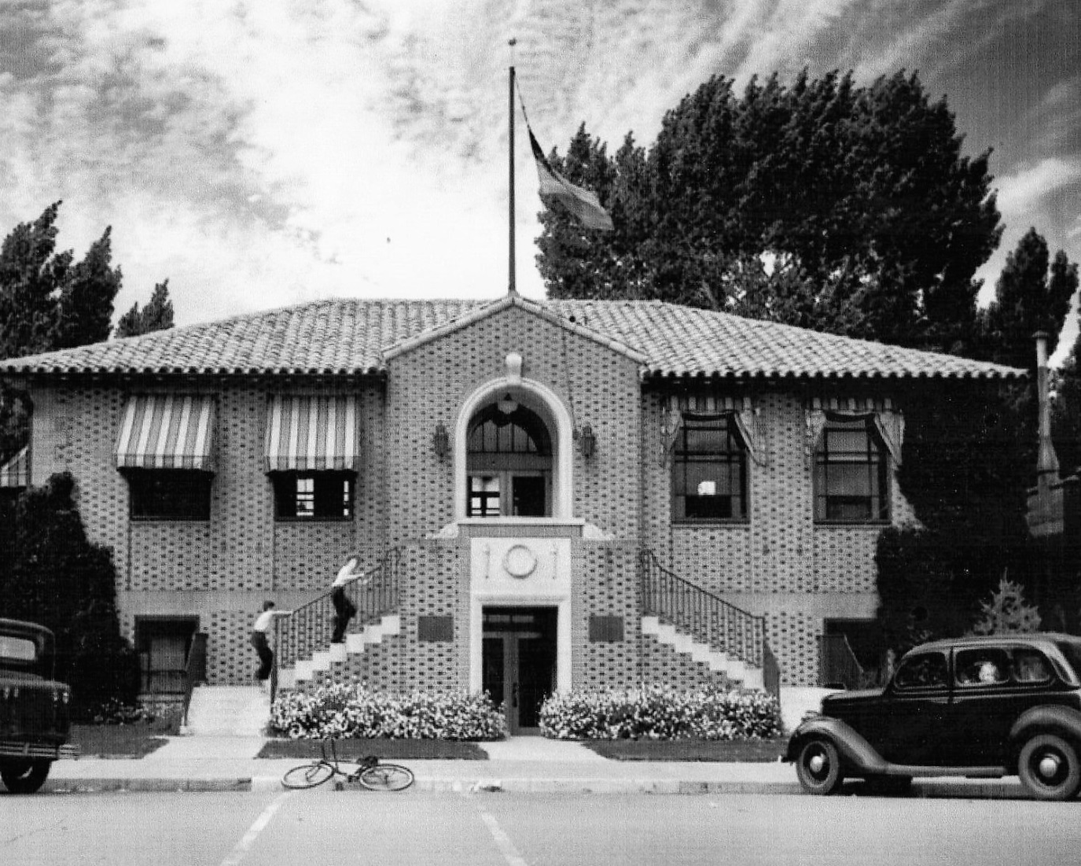
THANK YOU FOR YOUR CONTINUED SUPPORT!
A community partnership between the City of Sparks, the Sparks Heritage Foundation, and local volunteers that is more than 30 years old.
QUESTIONS?

